Slide 1
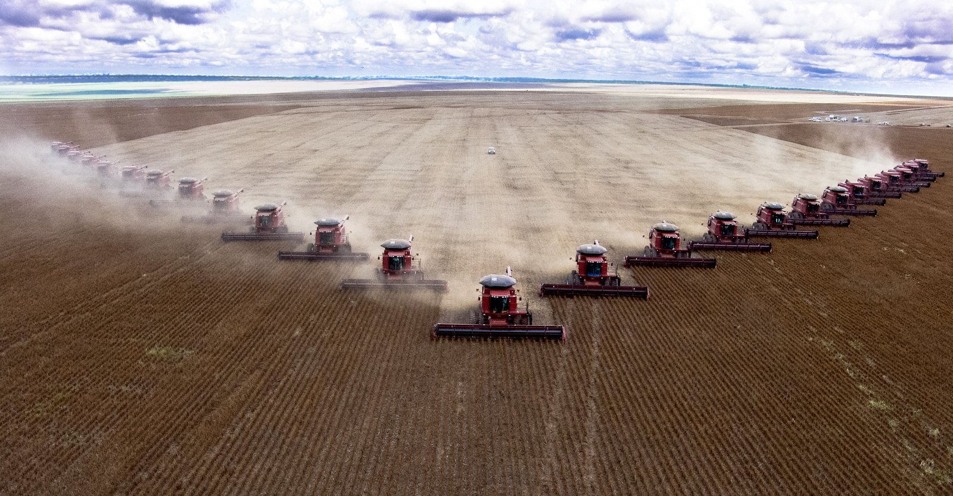
Factory Farming
By: Justin Davis, Blake Weatherly, Jadon Jackson, and Kaleb Kindle

Slide 2
Background of Factory Farming
What is factory farming? How is it different from “regular” farming?
The new industrial age of farming.
Yield more product
Yield more consistent product
Yield product at faster rate
And Is driven by profit, therefore incentivised to decrease cost.
Notes:
<JUSTIN>

Slide 3
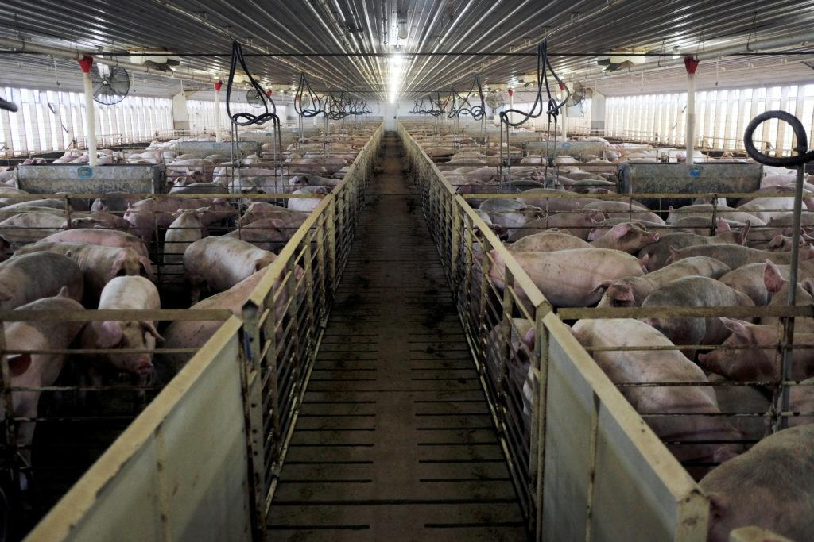
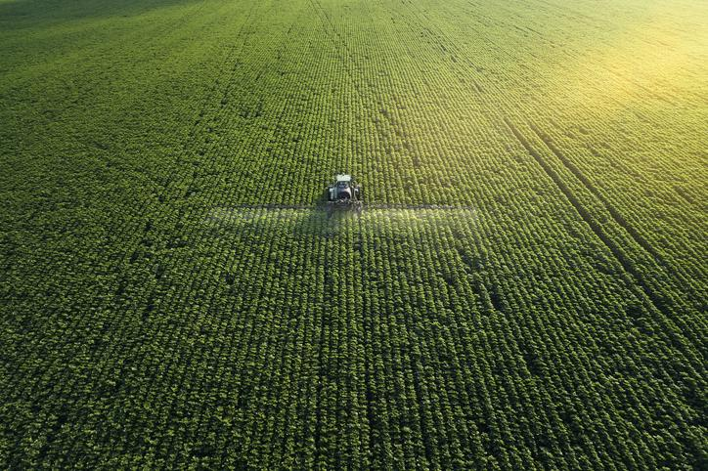
Ethical Dimensions of Factory Farming
Good
Produces vast amounts of food
Isn’t generally limited by its geography
Bad
Massive amounts of greenhouse gasses (11%)
Animals sometimes mistreated

Slide 4
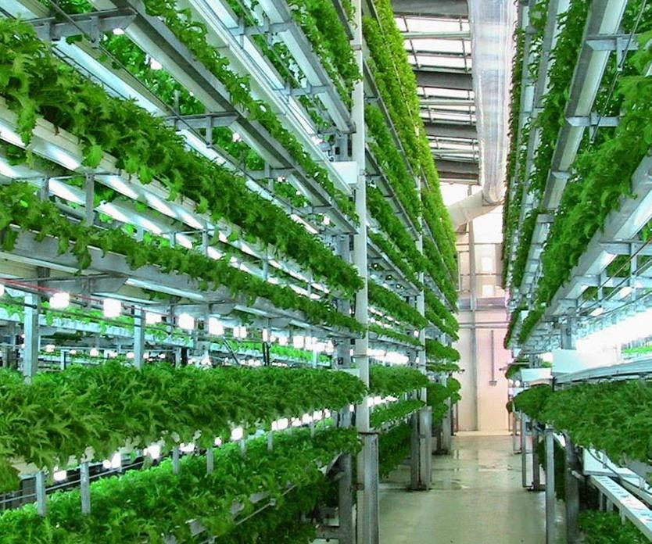
Types of Factory Farming?
Live Stock
Tyson Foods
Cargill Farms
Agricultural
Japan’s Indoor factory farms for vegetables
More consistent source of food
More sanitary conditions (less fear of spreading COVID)
Able to produce more than 11,333 heads of lettuce a day with one factory (lettuce is just one of many varieties of vegetables produced at once)

Slide 5
Why factory farming is more Effective than traditional farming
Factory Farming is more effective than traditional farming, as factory farming can produce more product in less time and maintenance. This is ideal for any business.
- Provides ample jobs and stimulates local economy
Factory Farming allows workers to be more efficient
- Automation helps farmers increase output tenfold

Slide 6

The cost efficiency of factory farming
Factory Farming saves a lot of money for the businesses and consumers alike, for three main reasons:
FF systems consolidate and optimize the supply chain
FF is time efficient, preventing additional costs that would appear
FF is more efficient than traditional farming per acre, making significantly more profit while at similar acreage

Slide 7
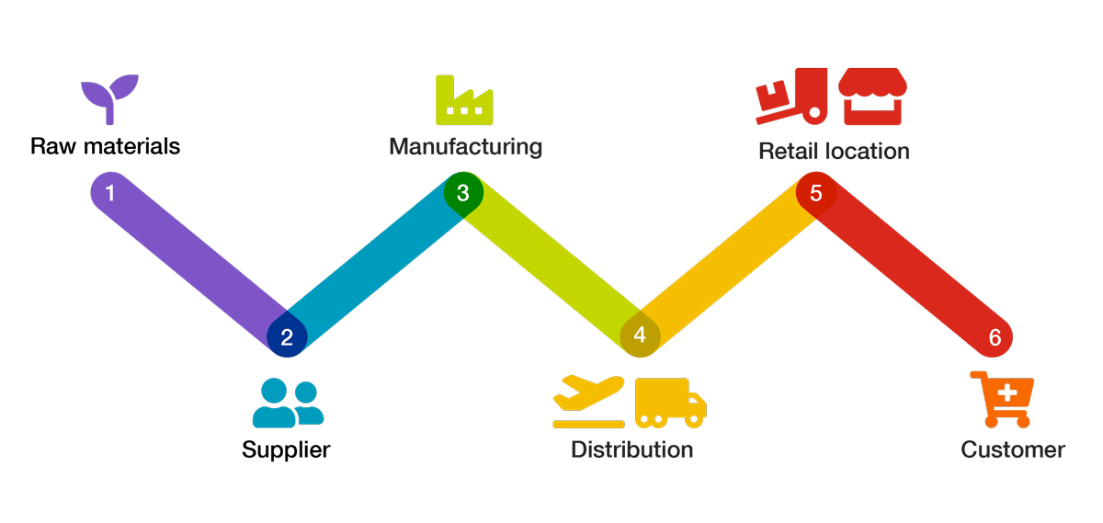
Optimization of the Supply Chain
What is a supply chain?
A supply chain is the sequence of processes involved in the production and distribution of a commodity
Factory farms generally operate within a vertically integrated system, where the company has control over the entire supply chain. This makes it significantly cheaper for them to get the food to shelves, in turn making it cheaper for consumers
Ex: National Beef

Slide 8
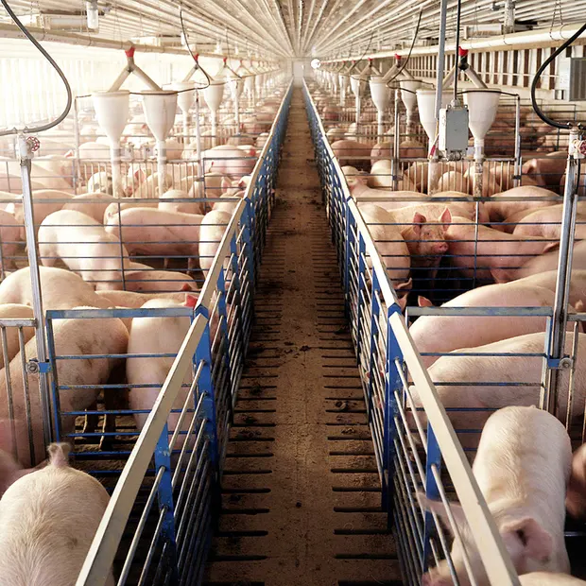
Time Cost Efficiency
Animals on factory farms are produced and processed at a very an intense rate. Along with condensed spaceage, FF’s can better utilize any and all logistical systems at their disposal, thereby taking full advantage of the eloted time.

Slide 9
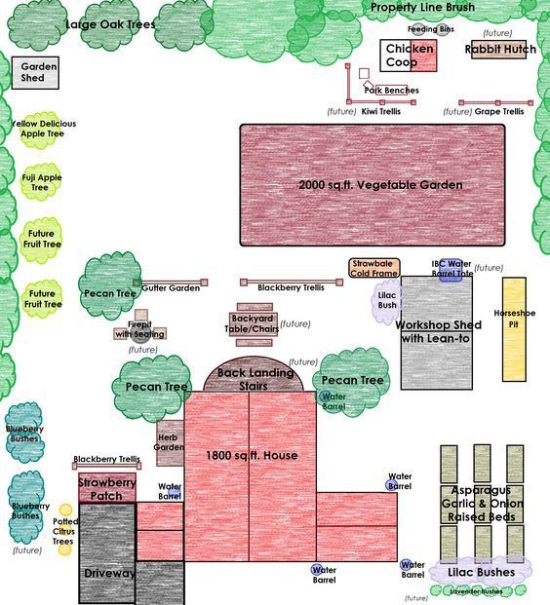
Cost-Efficient Land Usage
Due to much consolidation of plants and animals it allows FF’s to utilize their resources in a more confined way. This also allows them to put a factory farm relatively anywhere.
Can make multiple food products in one location
Will take full advantage of every acre
FF’s pay taxes on land; Stimulates local economy

Slide 10
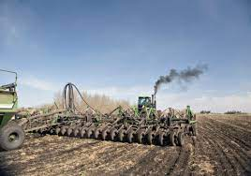
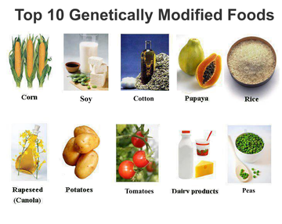
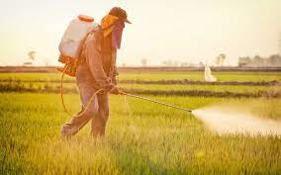
Emissions, Chemicals, and GMO’s
Notes:
Now i would like to talk about Emissions, Chemicals, and Genetically modified organisms

Slide 11
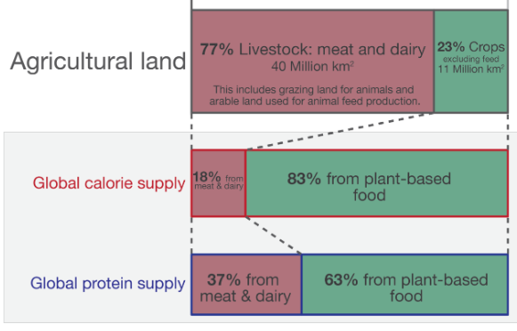
Emissions
Where do they come from?
Livestock . . . . . . . . . . . . . . . . . . . . 39%
Agricultural Operations . . . . . . . . . 45%
Processing and Transportation . . . 16%
(Livestock Operations) . . . . (74)%
(crops). . . . . . . . . . . . . . . . . (10)%
(P&T) . . . . . . . . . . . . . . . . . . (16)%
Livestock
Takes up 80% of agricultural land
Produces 20% of the worlds kcalories
Plants
Take up 20% of agricultural land
Produces 80% of the worlds kCalories
blame the cows
Notes:
Where.. Livestock is
Starting with emissions. Where do they come from? Within the factory farming process, 39% of emissions

Slide 12
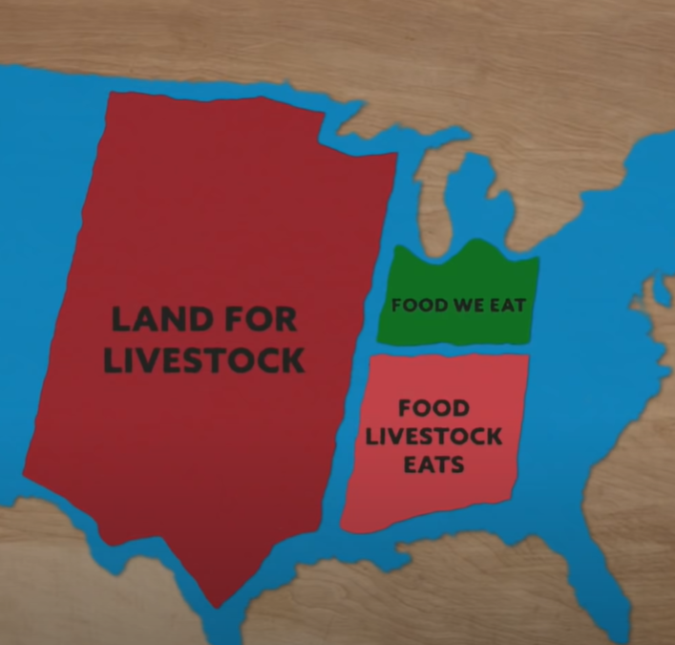
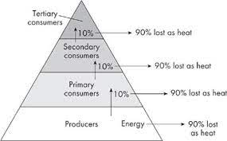
Energy & plant-based protein
Producers carry 10x more kcal than Primary Consumers.
Factory farming animals is largely a result of high demand
Hamburger = 30 PBs, but require the same amount of water

Slide 13
Chemicals and GMO’s
Fertilizer
Accelerate plant growth
Protect plant growth
Used in factory farming and traditional farming
Insecticide/Pesticide
Protect the plant
Used in factory farming and traditional farming.
Genetically Modified Organisms
Result of natural selection and selective breeding
Dogs, cats, plants, livestock, everything.
Literally the result of farming

Slide 14
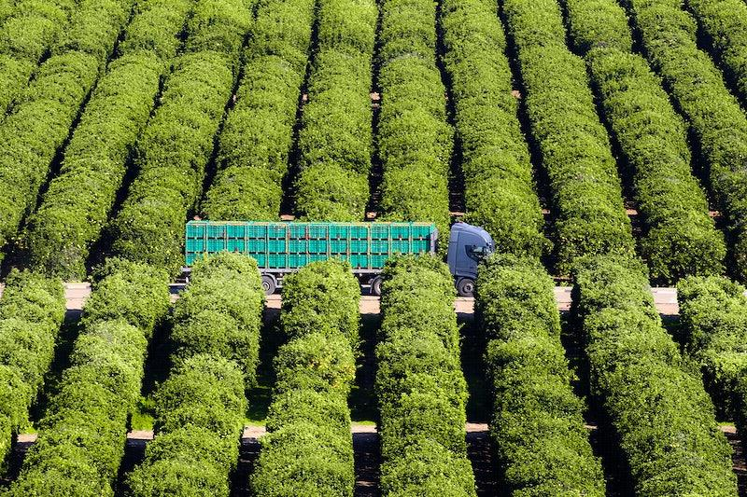
The impact of factory farming
Factory farming allows meat and other products to be affordable all season round, rather than being available when animals are in our region.
Factory farming allows consumers to shop at a cheap rate. Also allows for livestock product to be produce on a large economic scale,
It Improves Production Efficiencies
Factory farms make its possible for market variety in every season

Slide 15
Traditional Farming V. Factory Farming
Factory farming has just as many advantages as there are disadvantages. The ability to manipulation the feed and grains in bulks because it makes production faster. With factory farming the ability to carefully breed the different plants and their different species makes them more efficient. With the help of modern-science technology. Even though the productivity is more efficient than traditional farming the amounts of pollutants being created from their disposal treatments creates bad environment for the traditional farming. Also with factory farming has to be frequently monitored meanwhile traditional farming takes little to no oversight.
Traditional farming integrates a diversity of organisms that work together that maintain traditional farming’s equilibrium. Advantages in traditional farming in the promotion and protection of indigenous and local seed varieties. With this type of farming the whole course is depending nothing but nature itself versus the environment being controlled in factory farming. Disadvantages with traditional farming would be the erosion of soil due to “ nature running its course” which is knowing when and when not to plant. The depletion of nutrients in soil from slash and burn due to the amount of time it takes to regenerate for the next season.

Slide 16
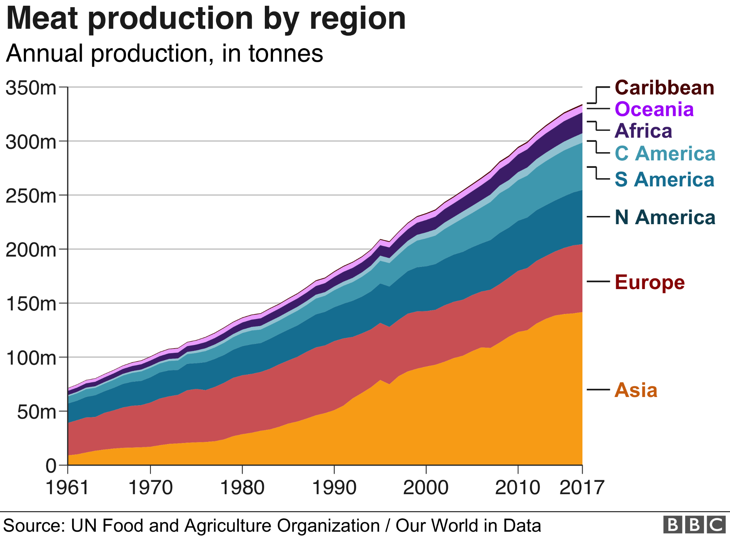
The US has two of the largest factors behind the continuation and dramatic increase of factory farming. Around the world rise of global meat consumption and the growing demand for cheap meat.

Slide 17
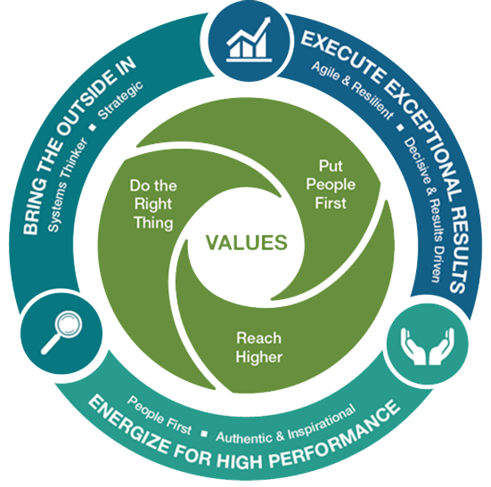

Corporate Culture
Examples:
Tyson Foods, Inc.
Faith, Family, Hard Work, and Tradition of doing what’s right
Cargill Farms
Nourish the world in a safe, responsible, and sustainable way
Do the right thing, put people first, and reach higher

Slide 18
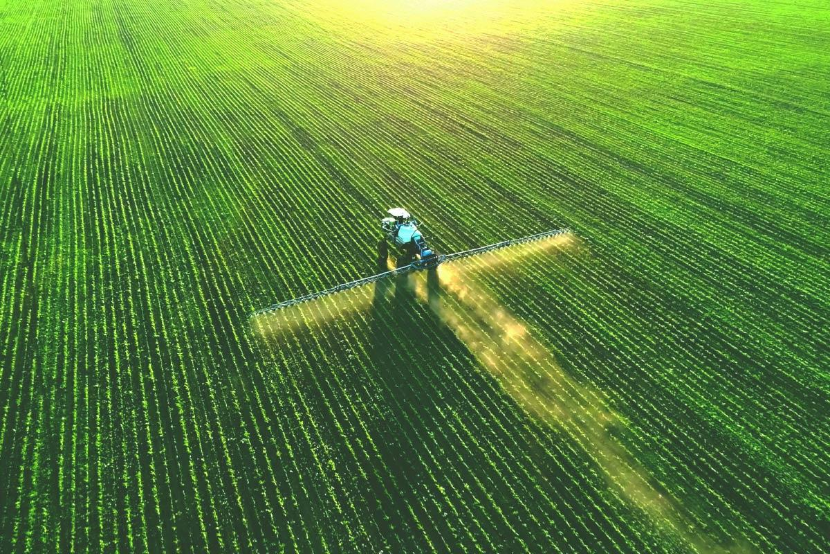
Pro
Production all year long
Important for many local economies
No geographic limitations
Every part of the animal is used
Increased food production
Lower customer cost (cheaper for the consumer)
99% of the US’s livestock is factory farmed
Consistent quality of product (meats/plants)
Greater food availability
More employment opportunities
Larger variety of food
Crop rotation to revive the soil

Slide 19
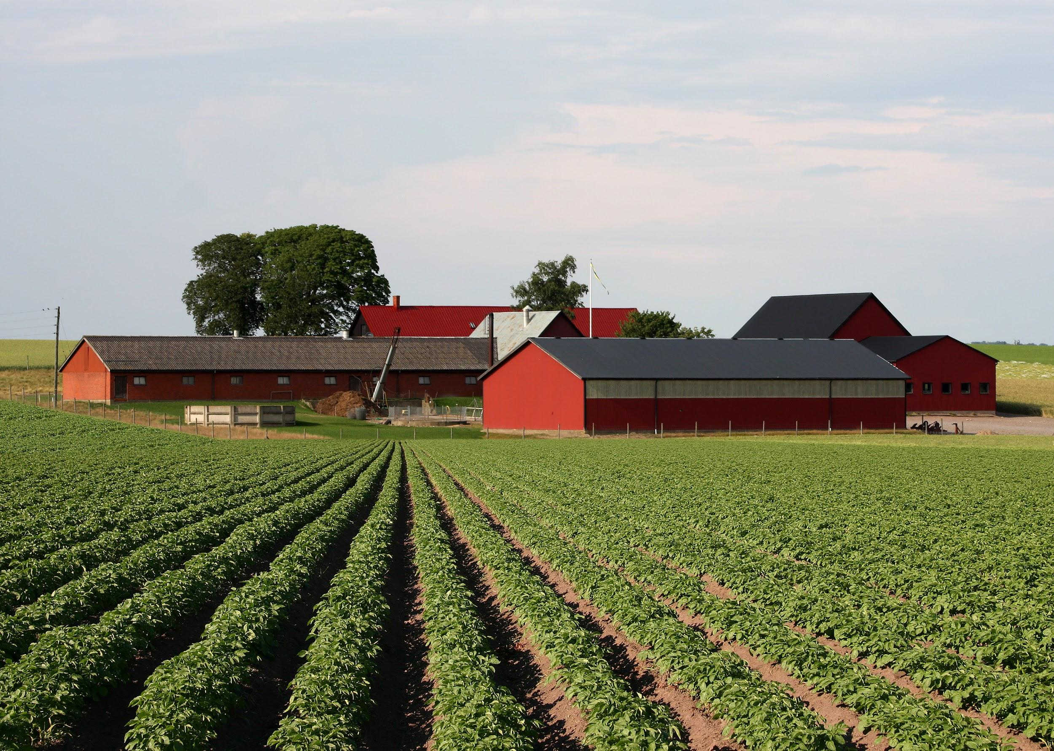
Con
May yield more profit, but the practice is still very expensive
Smaller spaces for the animals
With large amounts of animals, large amounts of food is needed
Environmental concerns
Negatively affects small business agriculture
High level of water consumption
Lots of animals in a small area

Slide 20
IPAC
Issue:
Factory Farming practices are often considered unethical, considering how animals are mistreated and the subsequent increase of emissions from said factories.
Principle
Proportionality Ethic - The good outweighs the bad, no better alternatives
Utilitarianism Principle - Create the greatest good for the greatest number of people.
Application
Utilising the proportionality Ethic would allow for the utilitarian practice of Factory Farming to succeed in the market and feed as many people as possible.
Conclusion
Factory Farming is simply the incorporation of modern farming techniques to accommodate the high demand of food. An operation of this scale is crucial to feed nearly all Americas diet.

Slide 21
Resources
https://asia.nikkei.com/Business/Business-trends/Factory-grown-veggies-comfort-Japan-s-germophobic-shoppers
https://thehumaneleague.org/article/what-is-factory-farming
https://www.ecowatch.com/tyson-foods-land-use-factory-farming.html
https://www.comparably.com/companies/smithfield
https://www.tysonsustainability.com/people/employees/engagement-and-retention#:~:text=We're%20a%20company%20built,stay%20true%20to%20these%20values.
https://careers.cargill.com/life-at-cargill
https://www.aspca.org/news/why-are-factory-farmed-products-so-cheap#:~:text=Factory%20Farming%20Systems%20Monopolize%20the%20Supply%20Chain&text=This%20means%20that%20factory%20farms,less%20at%20the%20grocery%20store
https://ffacoalition.org/articles/its-time-that-we-factor-out-factory-farming/#:~:text=Furthermore%2C%2099.9%25%20of%20chickens%20are,%2C%20National%20Beef%2C%20and%20Hormel.
https://www.mossyoak.com/our-obsession/blogs/the-pros-and-cons-of-industrial-agriculture
https://environmental-conscience.com/factory-farming-pros-cons/
https://www.epa.gov/ghgemissions/sources-greenhouse-gas-emissions
https://foodprint.org/issues/pesticides/#:~:text=Industrial%20agriculture%20relies%20on%20two,%2Fmold%20diseases%20(fungicides).

Slide 22
https://www.ucdavis.edu/food/news/making-cattle-more-sustainable#:~:text=Each%20year%2C%20a%20single%20cow,the%20Department%20of%20Animal%20Science.
https://ourworldindata.org/agricultural-land-by-global-diets#:~:text=Livestock%20takes%20up%20nearly%2080,required%20to%20produce%20our%20food.

